Slide 1

USER EXPERIENCE (UX) ANALYSIS FOR FLEXTRADE ONLINE SHOPPING APP
By Nathalie Iredje

Slide 2

TABLE OF CONTENT
Background
Business problem & Objectives
Data Analysis & Findings
Insights & Recommendations
Action Plans & Conclusion

Slide 3
BACKGROUND
FlexTrade is a well-known company in the online shopping world that have been making shopping easier and better for a long time. They sell all kinds of products, from electronics to clothes. Their app is designed to be easy to use, hoping to make shopping fun and simple for everyone. In today's competitive e-commerce landscape, understanding user behaviour and optimizing the online shopping experience is crucial for driving business growth. By analysing key metrics such as conversion rates, bounce rates, session duration, and user feedback, we will uncover valuable insights into our customers' behaviour and preferences. Through data-driven recommendations, we can optimize our website's design, checkout process, and product recommendations to enhance user experience and increase sales.
This presentation will provide a clear understanding of the current state of our online shopping application, highlight the opportunities for improvement, and action plans to achieve our business objectives.

Slide 4

BUSINESS PROBLEM & GOALS
Even though lots of people download and use the FlexTrade app, not everyone ends up buying something. There are a few problems:
• High Bounce Rate: Many users leave the app quickly without buying anything.
• Cart Abandonment: Users put items in their cart but don't complete the purchase.
• Low Average Order Value: The amount of money users spend is lower than what FlexTrade would like.
• Lots of Competition: There are many other shopping apps out there, so FlexTrade needs to stand out
The goals are to:
• Find UX Problems: Look at how users behave and what they say to find out what needs to be better.
• Make Checkout Better: Make it easier and quicker for users to buy things.
• Suggest Personalized Products: Use what we know about what users like to suggest other things they might buy.
• Get Users to Buy More: Figure out ways to encourage users to spend more money

Slide 5
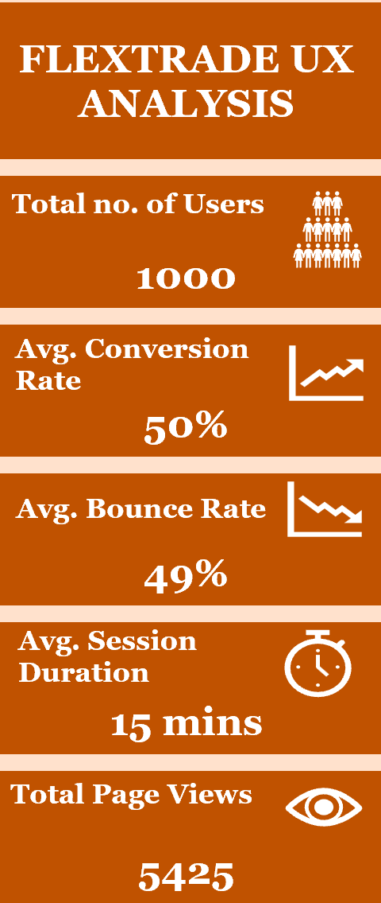
DATA ANALYSIS & FINDINGS
1. Session Duration Analysis: From the analysis, it was discovered that users typically spend 15mins (898s) on the app. It was also seen that the average session duration does not necessarily increase as the bounce rate increases and vice versa, therefore there is no actual relationship between bounce rate and session duration.
2. Bounce Rate & Conversion Rate Analysis: From the analysis, it was discovered that when bounce rate increases, the conversion rate drops and when conversion rate increases, the bounce rate drops. Therefore, this means that when the conversion rate is high, the bounce rate reduces, and this establishes a direct relationship between the two metrics.
4. Cart Behaviour Analysis: At 50% conversion rate, users added more items to cart (54 items) while at 90% conversion rate, users added the least items to cart (4items). Also at 6% conversion rate, users added 42 items to cart. This shows that at low conversion rates, users added more items to cart without the specific intention to buy while at higher conversion rates where users added lower items to cart suggests planned purchases where users only added items they intended to buy.

Slide 6
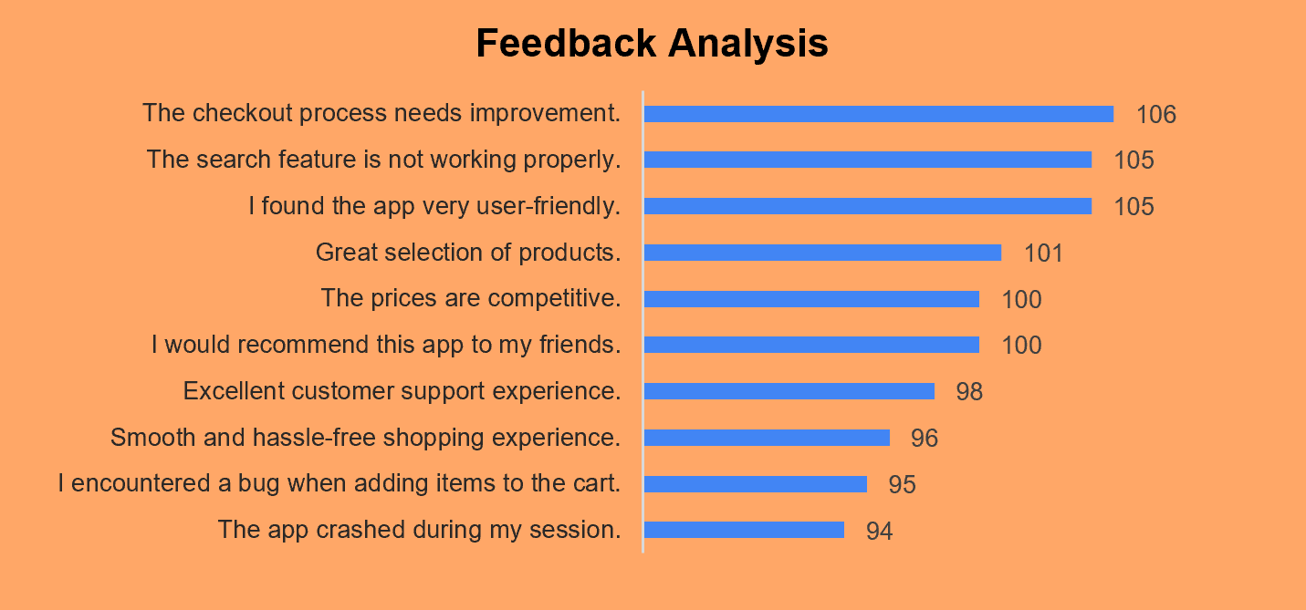
DATA ANALYSIS & FINDINGS
5. Feedback Analysis: From analysing the feedback of users, it was discovered that:
- 106 users felt that the checkout process needed improvement
- 105 users said that the search feature is not working properly
- 95 users encountered a bug while adding items to cart
- 94 users had the app crash during their sessions
- 105 users found the app user friendly
- 101 users felt we had a great selection of products
- 100 users found that our prices are competitive
- 100 users would recommend this app to their friends
- 96 users had a smooth and hassle-free shopping experience
- 98 people had an excellent customer service experience
In summary 60% of users had positive feedback while 40% of users had negative feedback. We need to focus on addressing the issues raised by the users with negative feedback while constantly improving on the areas that were positive to foster good customer experience.
6. In 2022 we recorded the highest average conversion rate (53%) and the lowest average bounce rate (48%) compared to the other years.

Slide 7

INSIGHTS & RECOMMENDATIONS
1. The average conversion rate of 50% is good, however, we need to identify opportunities for improvement which will lead to a boost in conversion rates. A 49% bounce rate suggests that nearly half of the visitors are leaving the website without taking any action. This could be due to various factors such as poor user experience, slow loading times, or irrelevant content.
RECEMMENDATIONS: (i) Optimize website performance by improving its speed and making the mobile app to be very user friendly (ii) make navigation on the application easier so that users can find what they want without hassle (iii) use clear call to actions to guide users towards what they want
2. Users, on average, spend 15 minutes on the app. This suggests a good level of engagement.
RECOMMENDATION: We need to analyse user behaviour to identify pages or features that users spend the most time on and then we should focus on enhancing these areas to further increase user engagement, therefore increasing conversion rates.
3. A clear relationship exists between bounce rate and conversion rate. A higher bounce rate indicated that users were leaving the website quickly without taking any action, which negatively impacted conversions while a lower bounce rate suggested that users were engaged with the website and more likely to convert.
RECOMMENDATIONS: (i) Use personalized marketing campaigns to attract and retain users. (ii) Enhance user experience on the website by improving speed, faster checkout processes/reduced check out steps (iii) Offer more promotions/combo deals on the website to improve sales/conversions

Slide 8
INSIGHTS & RECOMMENDATIONS
4. The analysis revealed an interesting trend: higher conversion rates are often associated with fewer items added to the cart. This suggests that users with a higher intent to purchase are more focused and add only the necessary items while lower conversion rates might indicate impulsive behaviour, where users add items to the cart without a specific buying intent.
RECOMMENDATIONS: (I) Offer product recommendations by using data-driven insights to suggest relevant products that complement the items in the cart. (ii) Personalize recommendations based on user behaviour and preferences. (iii) Reduce the checkout steps and offer secure and fast payment methods (iv) Implement abandoned cart recovery by emailing users about the items the left in their carts, also encourage users to complete their sales by offering incentives or discounts at the checkout phase
5. From the feedback, 3 areas stood out: (i) Checkout Process: A significant number of users have reported issues with the checkout process, indicating a need for optimization and improvement. (ii) Search Functionality: The search feature is not functioning properly, leading to frustration and potentially lost sales. (iii) App Stability: App crashes and bugs are impacting the user experience and hindering smooth operations.
RECOMMENDATIONS: (i) Simplify the checkout process and allow non-registered users to be able to check out without signing up (ii) improve the accuracy and relevance of search results, implement auto-suggestions in the app to help users find their desired items/products on time and provide a more robust filtering and sorting options to refine search results (iii) Conduct thorough testing and fix bugs to improve app stability, release regular app updates to include new features and enhance user experience (iv) Leverage all the positive feedbacks by improving on them to drive user satisfaction thereby increasing sales (v) The app should be updated to align with evolving user preferences

Slide 9
INSIGHTS & RECOMMENDATIONS
6. The combination of a high conversion rate and a low bounce rate in 2022 indicates a strong overall performance. This suggests that the app was highly engaging and effective in converting visitors into customers.
RECOMMENDATIONS: (i) We need to identify the specific strategies or campaigns implemented in 2022 that contributed to the high performance. (ii) We need to Implement the similar strategies in the current year to maintain or improve performance. (iii) We need to stay updated on industry trends and consumer behaviour

Slide 10

ACTION PLANS & CONCLUSION
• Enhance User Experience: By improving user experience through intuitive design, faster load times, and smoother app navigation, we can reduce bounce rates and increase session duration, ultimately leading to higher conversion rates and customer satisfaction.
• Optimize Product Discovery and Checkout: By enhancing product search, personalization, and the checkout process, we can increase average order value and reduce cart abandonment.
• Leverage Data-Driven Insights: By analysing user behaviour and performance metrics, we can identify opportunities to optimize marketing campaigns, personalize user experiences, and improve overall website performance.
• Implement Effective Marketing Strategies: By utilizing targeted marketing campaigns, social media, and email marketing, we can increase brand awareness, attract new customers, and drive traffic to the website.
• Prioritize Customer Support: By providing excellent customer support, we can improve customer satisfaction, build brand loyalty, and reduce negative reviews.
CONCLUSION
In conclusion, by addressing the identified challenges and implementing the recommended strategies, we can significantly improve our online store's performance and achieve our business goals of increasing conversion rates, reducing bounce rates, and driving overall growth.

Slide 11

THANK YOU!

